Slide 1
Ecological and Evolutionary Genomics
BIO 594-0004
Spring 2019
January 20, 2015

Slide 2
Instructor: Carlos Prada
CBLS 181
401 874 5767
prada@edu
GitHub
http://bio-594.slack.com/
When and where do we meet:
Tuesdays 9 - 10:30 AM CBLS 435 Thursdays 9 - 10:30 AM CI 200

Slide 3
Learning Objective
The goal is to recognize the diverse possibilities that genomics allow to answer evolutionary and ecological questions. Together we will enrich our conceptual understanding of genomics and the types of analysis that can be performed with genome scale data. At the end of the course participants will be able to design experiments to answer their own questions and provide a detailed map of the methodological steps needed to carry out a robust study using genomic tools.

Slide 4
What do we suppose to do in this class?
Discuss, discuss, discuss!
We are here to dissect to the best of our possibilities the assigned articles and then use that info to design a project that uses genomic tools to answer and ecological or an evolutionary question.
We are meeting two days:
on Thursdays we will introduce a new subject (lecture)
on Tuesdays we will discuss two/three articles related to that subject

Slide 5
Why do we have a lecture/recitation
before each discussion?
The presentation is key to have fruitful subsequent discussions because it will allow us to get a deeper understanding of the papers.
The aim of the presentation is to:
- introduce the subject (theory, methods, controversies)
- discuss all the vocabulary in reviews and research papers
- an opportunity for participants to clarify concepts (ASK!)
At least one review paper with baseline info to develop the presentation. The review paper is MANDATORY for non-presenters too. Presenters should read also the upcoming discussion papers to make sure that they include all the necessary vocabulary in those papers in their presentations.
Presentation: 30-60 min (any strategy). Meet with me a week (seven days) before the presentation and as many times as you want.

Slide 6
What are we doing in this class?
There are four parts to this course:
Class participation (15%)
Student presentations (20%)
presentation (30-60 min)
Discussions (25%)
summary writeups
discussion writeups
Proposals (40%)
proposal (20%)
updated proposal (10%)
reviews from other proposals (10%)
panel discussions and panel summaries

Slide 7
What do we suppose to do in this class?
Discussions
summary writeups
(750-1000-word compare and contrast of the articles). Each student has to submit at least 5 of them before each discussion (earlier than 9 am on Tuesdays). Examples are provided here
discussion writeups
(1000-2000-word summary of the discussion, which needs to be uploaded to the class GitHub within 48 hours of the discussion and it is submitted by one of the two discussion leaders). Each student leads two discussions with a partner.

Slide 8
What do we suppose to do in this class?
Proposals
proposal (5-page proposal, single spaced, 1”, 2 aims)
updated proposal (addressing reviewers comments)
reviews from other proposals (each will review at least three proposals from their peers)
panel discussions and panel summaries (proposals will be evaluated and ranked as an NSF panel. Panelists will have to generate a panel review for each proposal)

Slide 9
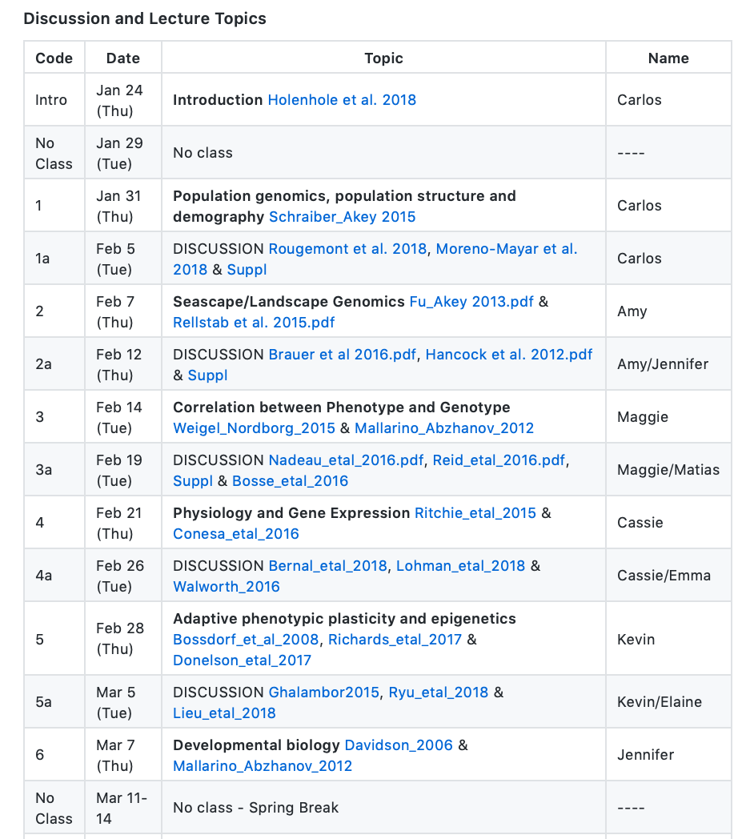

Slide 10
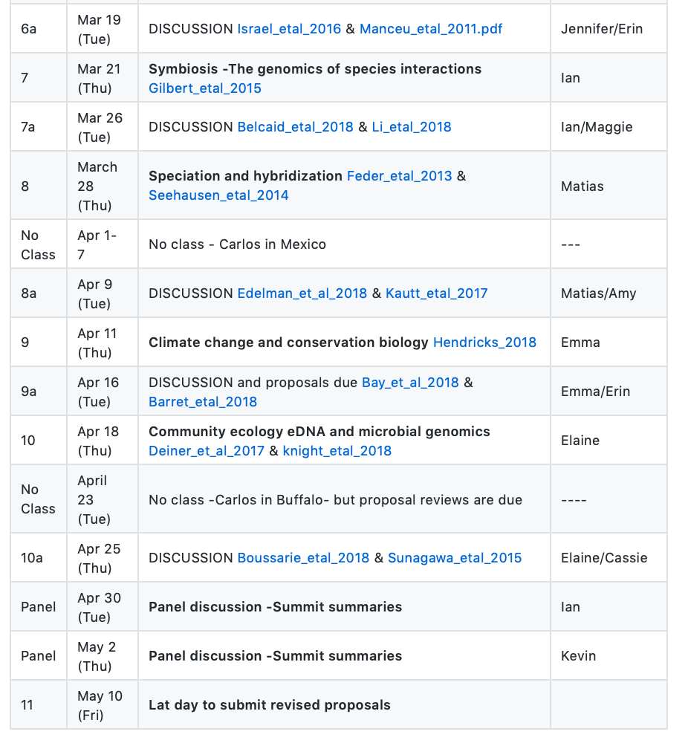

Slide 12
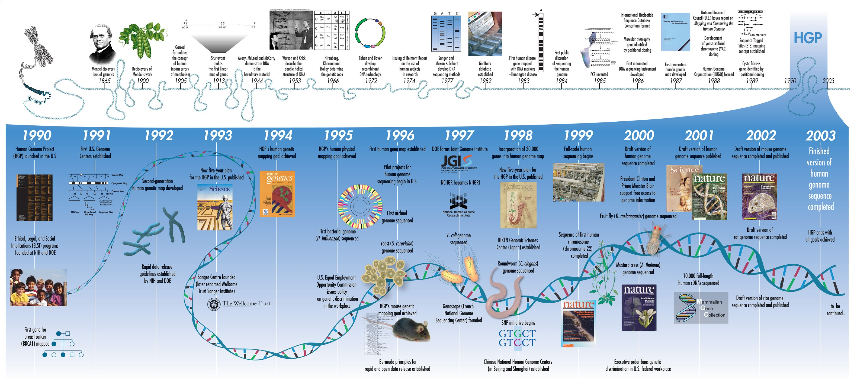
A timeline to genomics
NHGRI – National Human Genome Research Institute
http://www.genome.gov/dmd/img.cfm?node=Photos/Graphics&id=85325

Slide 13
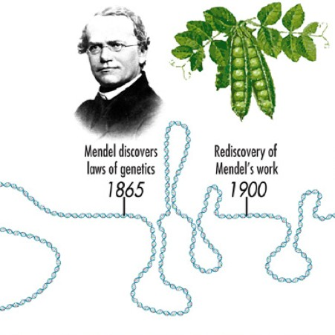
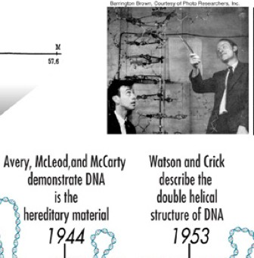
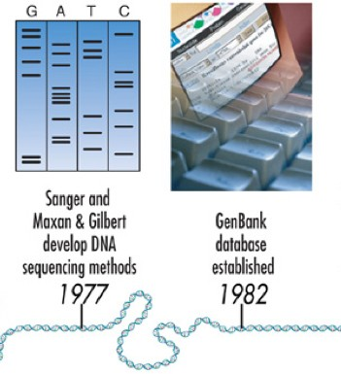

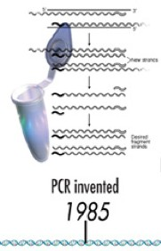


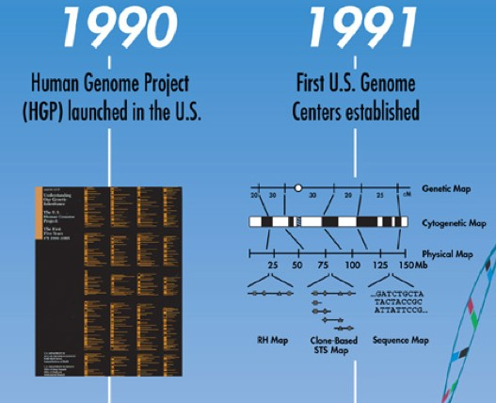
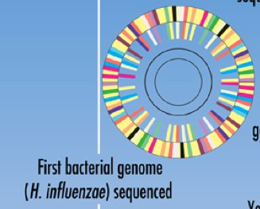

Slide 14




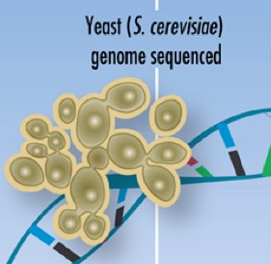
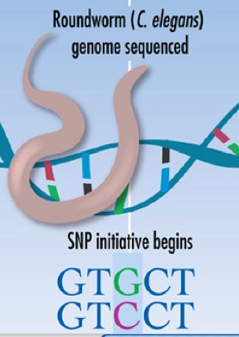


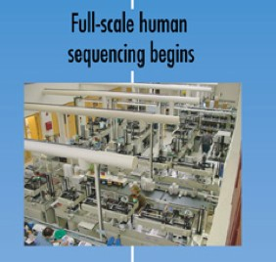


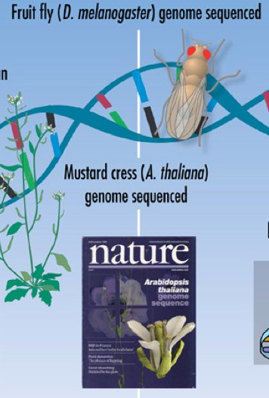

Slide 15
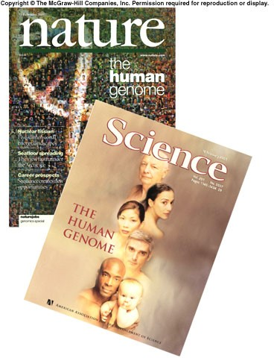
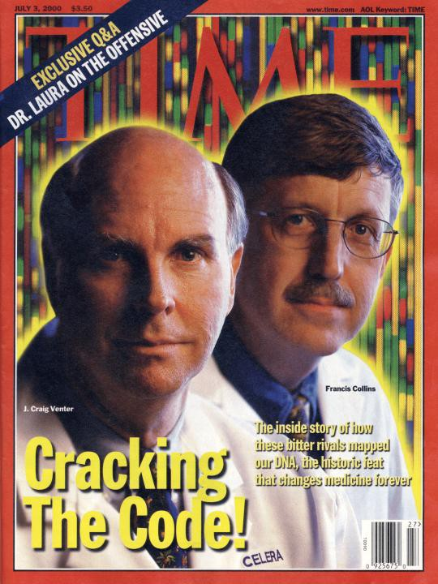
The Human Genome
February 2001

Slide 16
Growth in genomics thanks to advances in…
MICROTECHNOLOGY
DNA/RNA sequencing…
COMPUTATION
human genome assembly: 500 million trillion sequence comparisons
COMMUNICATION
online sequence and expression databases

Slide 17
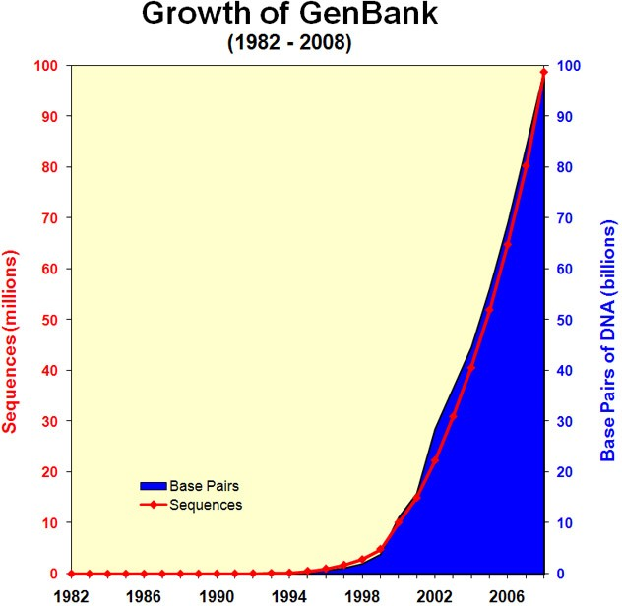
Genomes and Databases
Sequence Accession numbers are IDs that allow sequences to be easily deposited in and retrieved from online databases
DDBJ, EMBL, GenBank
The three main sequence
databases. They are redundant and work in concert
GenBank is the NIH genetic sequence database, an annotated collection of all publicly available DNA sequences
GenBank is maintained by the NCBI (National Center for Biotechnology Information)

Slide 18
The TRANSCRIPTOME
The GENOME
Transcription
RNA splicing
RNA editing
rRNA
mRNA translation
tRNA
DNA
Enzymes
Structure proteins
Transcription factors
Ion channels
Signalling proteins
Receptors
Catalysis
Synthesis
Transport
Transformation
The PROTEOME
Sugars
Amino acids
Lipids
Secondary metabolites
Hormones
The METABOLOME

Slide 19
The Structure of DNA

Slide 20
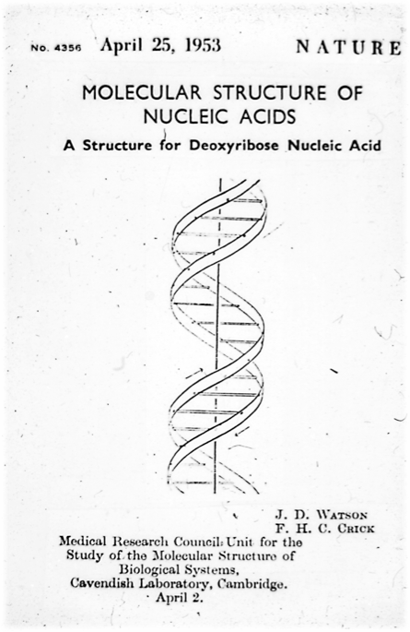
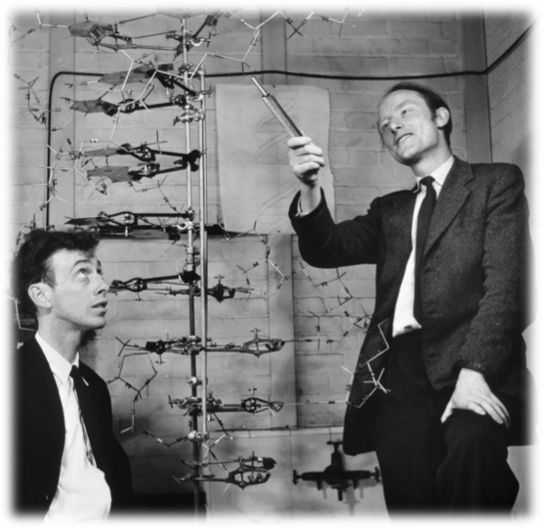
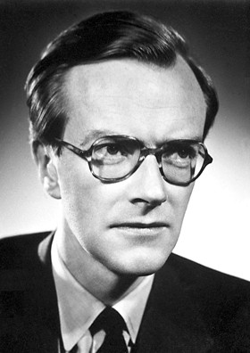
April, 1953

Slide 21
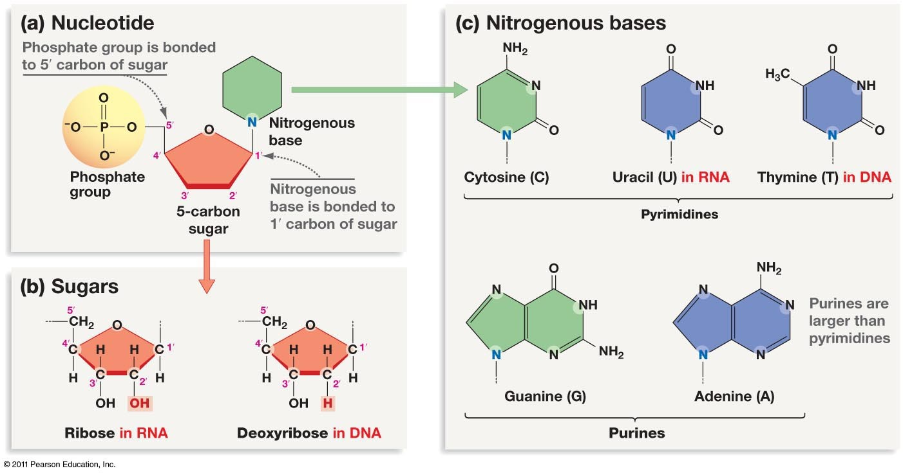
Nucleotides

Slide 22
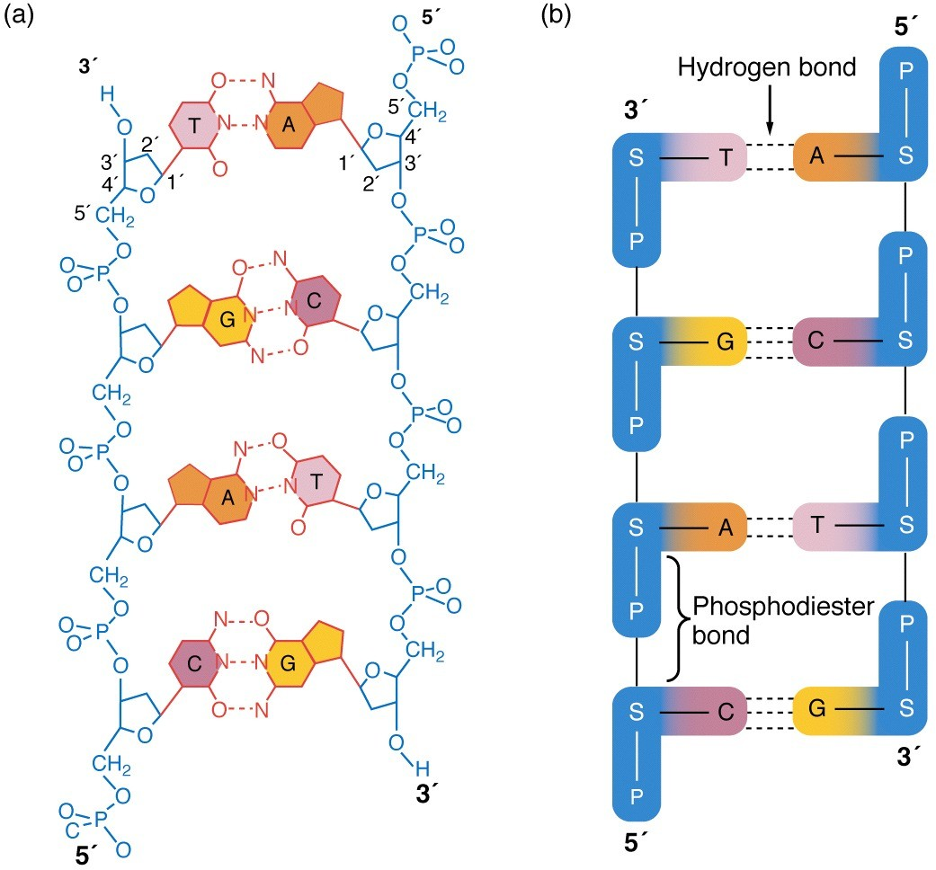
The double helix
DNA normally consists of two antiparallel polynucleotide chains
sugar–phosphate backbone

Slide 23
EUKARYOTE GENOME PACKAGING
from T.A. Brown, Genomes 2nd Ed.

Slide 24
DNA features
Replication: each strand serves as template for synthesis of complement, using rules of base pairing
Information: speciﬁed by sequence of nucleotides; may be copied into RNA
Mutation: replacement, insertion, deletion of nucleotide results in altered sequence

Slide 25
The Structure of Genes

Slide 26
Structure of genes
Gene = transcriptional unit
Gene encodes coding RNA (mRNA) or non-­‐coding RNA (tRNA, rRNA,miRNA...)
regulatory
DNA encoding functional RNA
region
RNA primary transcript
Gene is a functional element of the chromosome and is transcribed into RNA at the correct time and place in development or cell cycle
To some researchers, gene actually includes its adjacent regulatory region(s)

Slide 27
Genes have introns and exons
Intron: noncoding region of gene, excised by processing from primary transcript Exon: coding region of gene (exon sequence is included in mature transcript)

Slide 29
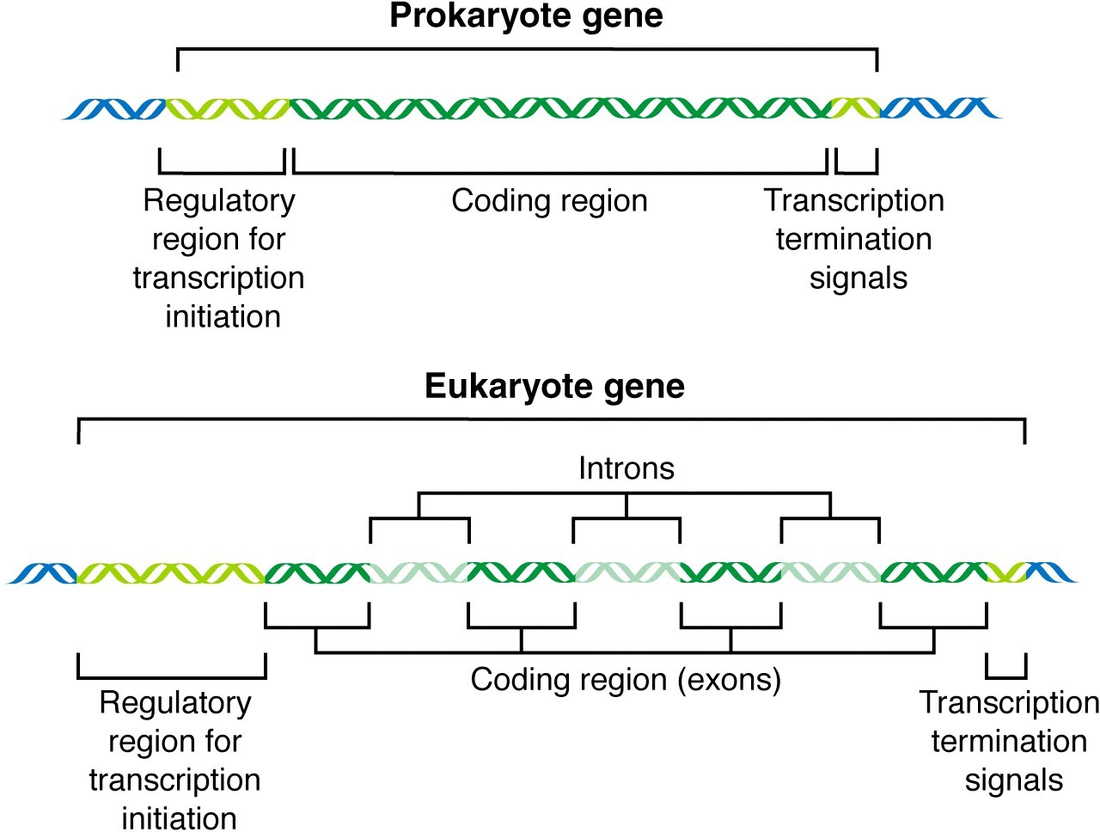

Slide 30
The Structure of Genomes

Slide 31
What is a genome?
The genome represents the whole genetic information of an organism
It is physically formed by DNA, except in some viruses where it is constituted by RNA

Slide 32
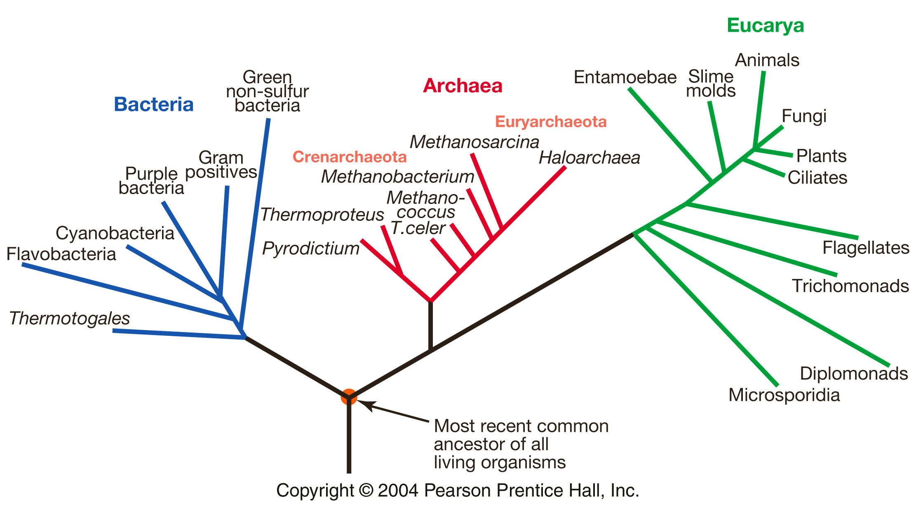
The 3 major domains of life
From Freeman & Herron, Evolutionary Analysis

Slide 33
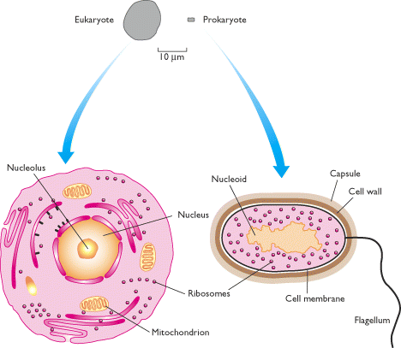
EUKARYOTES vs PROKARYOTES
NUCLEAR MATERIAL
→ Euk – within membrane-bound nucleus
ORGANELLES
→ Euk have other membrane-bound
organelles (mitochondria, chloroplasts,
golgi)
CELL MEMBRANE
→ Euk have semi-permeable membrane
with internal cytoskeleton
→ Prok have rigid plasma
membrane
from T.A. Brown, Genomes 2nd Ed.

Slide 34
Very different genome landscapes in prokaryotes and eukaryotes
In prokaryotes, genes are compactly arranged, with little or no spacer sequences in between (short intergenic regions) = most of the genome is coding DNA
In eukaryotes, there is considerable spacer DNA between genes (large intergenic regions) and within genes (introns) = most of the genome is ‘non-­‐coding’ DNA

Slide 35
Prokaryotic genome
Usually circular double helix
Gene-­‐dense: genes are close together with little intergenic spacer (compact genome)
No introns
Shorter genes with low frequency of gene families
Genes are organized in operons
tandem cluster of coordinately regulated genes
Several genes transcribed as single mRNA

Slide 36
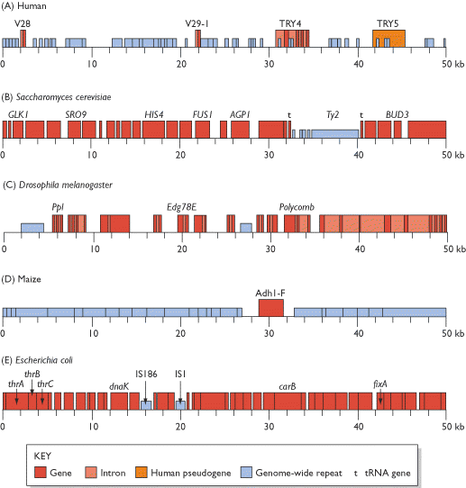
PROKARIOTIC
GENOME
Escherichia coli – non-coding DNA only 11% of total genome
from T.A. Brown,
Genomes 2nd Ed.

Slide 38
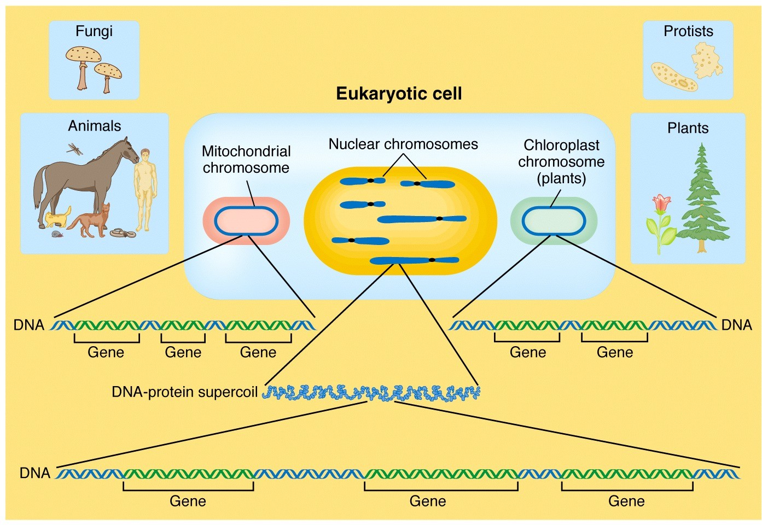
Eukaryotes: 2 or 3 different genomes per cell

Slide 39
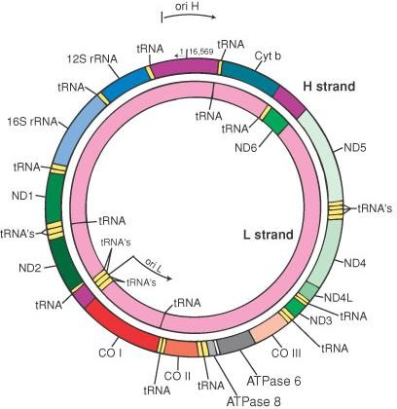
The Mitochondrial Genome
-­‐ Circular, 2-­‐10 copies per mitochondrion
-­‐ Resembles a reduced
prokaryotic genome in terms of organization and gene numbers
-­‐ The human mitochondrion genome encodes 37 genes: 13 protein-­‐coding genes involved in
the production of energy (oxydative phosphorylation) and 24 non-­‐coding genes involved in
mRNA translation (tRNAs, rRNA)
-­‐ Maternally inherited

Slide 40
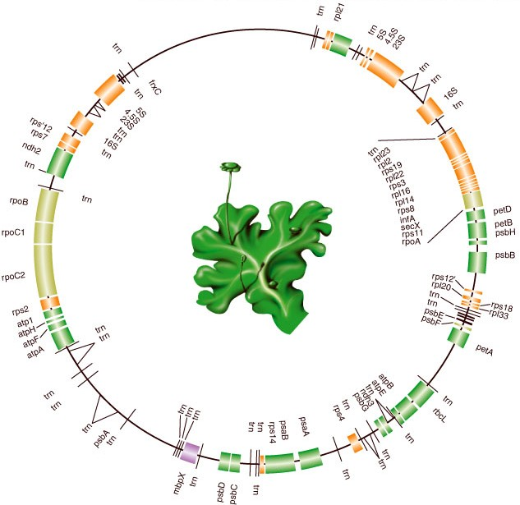
The Chloroplast Genome (plants)
-­‐ Circular
-­‐ Resembles a reduced prokaryotic genome in terms of organization and gene numbers
-­‐ Encodes genes mostly
involved in photosynthesis and electron transport
-­‐ ‘Maternally’ inherited (transmitted through the seed)
--Do not vary much in size
Marchantia (moss) CpDNA 121 kb

Slide 41
EUKARYOTE NUCLEAR GENOME
from T.A. Brown, Genomes 2nd Ed.

Slide 43
The non-­‐coding DNA of eukaryotic nuclear genomes
–Non-coding DNA:
introns
intergenic regions centromeric regions telomeric regions
– Most non-coding DNA is formed by identical or nearly identical repeated units (repetitive DNA)
Two types of repetitive DNA:
Tandem repeats (e.g. satellite DNA at centromeres and telomeric repeats at telomeres)
Interspersed repeats (mostly transposable elements)

Slide 44
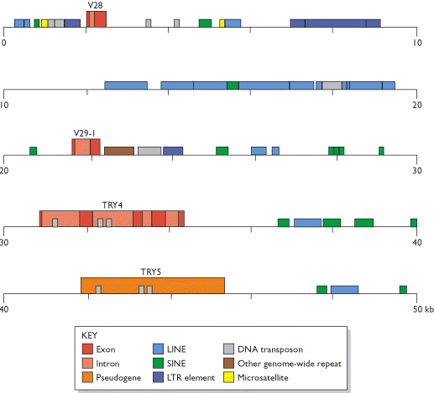
50-kb segment of the human b T-cell receptor locus on chromosome 7
from T.A. Brown, Genomes 2nd Ed.

Slide 45
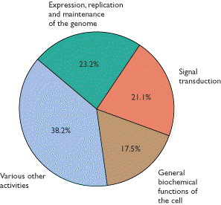
GENE CONTENT of EUKARYOTIC GENOME
A VERY small part contains genes
Categorization of the identified human protein-coding genes.
→ omits ~ 13 000 genes whose functions are not yet known.
→ segment labeled 'various other activities' includes, among others, proteins involved in biochemical transport processes and protein folding, immunological proteins, and structural proteins.
Based on Figure 15 of Venter et al. (2001).

Slide 46
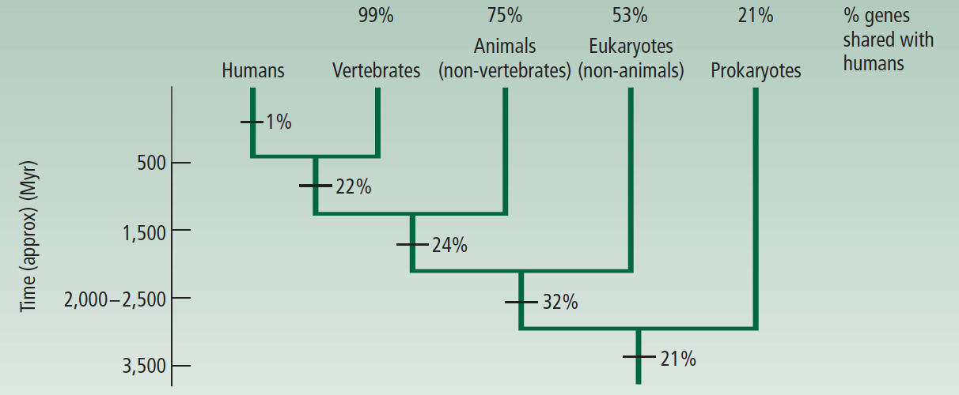
very few genes unique to humans
from Ridley (2004) Evolution
“vertebrate” genes
- include immune and nervous system genes
- humans: 100 nervous system genes
- worms/flies: 10 nervous system genes
homologous with all cellular life forms
→ regulate basic cellular machinery
greater complexity of cellular metabolism in eukaryotes
HOMOLOGY OF PROTEIN-CODING GENES
“animal” genes include Hox genes that control development

Slide 47
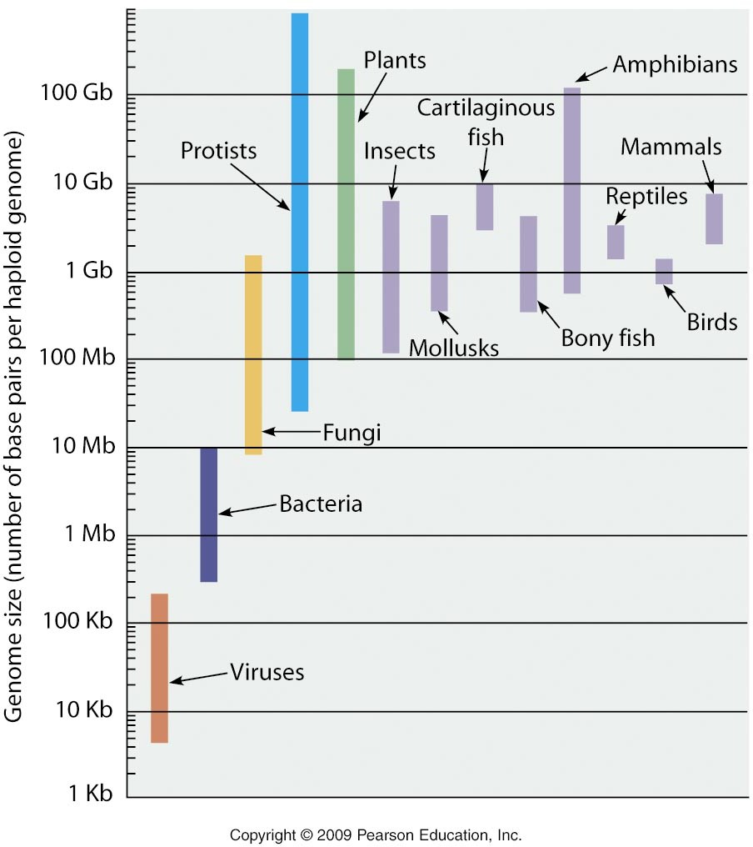

Slide 48
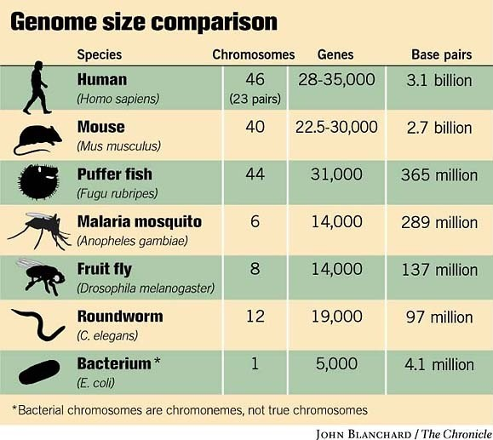
Gene number and genome size in eukaryotes
21,000
21,000
28,000

Slide 50
GENOME EVOLUTION
TWO ways in which NEW GENES could be acquired by a genome
1. By duplicating some or all of the existing genes in the genome.
→ whole genome duplication
→ duplication of single or part of chromosome (?? usually lethal or causes disease - Down’s)
→ duplication of single gene or group of genes
2. By acquiring genes from other species
→ lateral gene transfer
→ retroviruses and transposable elements

Slide 51
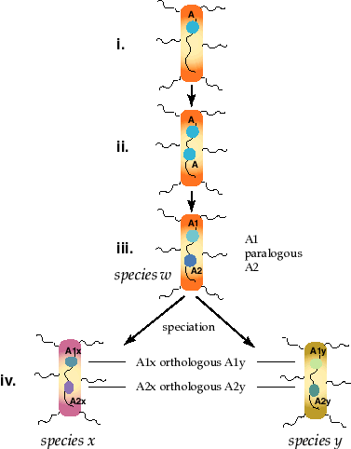
Gene Duplication: Orthologs and Paralogs…
Two genes are paralogous if derived from a duplication event, orthologous if derived from a speciation event.
i) Gene “A” in species “w”
ii) is duplicated producing initially two copies of A.
iii) With time the 2 copies diverge forming related genes A1 and A2. These two genes are paralogous to one another. Paralogy involves comparisons within a species.
iv) 2 species, x and y evolve from species w (common ancestor). Descendants of the A1 and A2 genes are now called A1x, A1y, and A2x, A2y to reflect which species they now occupy. A1x is orthologous to A1y and A2x is orthologous to A2y. The comparison is between two species. A1x and A2y are paralogously related as are A2x and A1y.

Slide 52
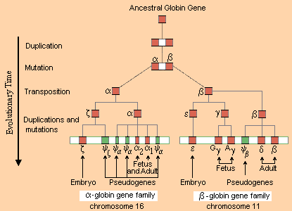
EXAMPLE OF DUPLICATION FOLLOWED BY SUB-FUNCTION PARTITIONING…

Slide 53
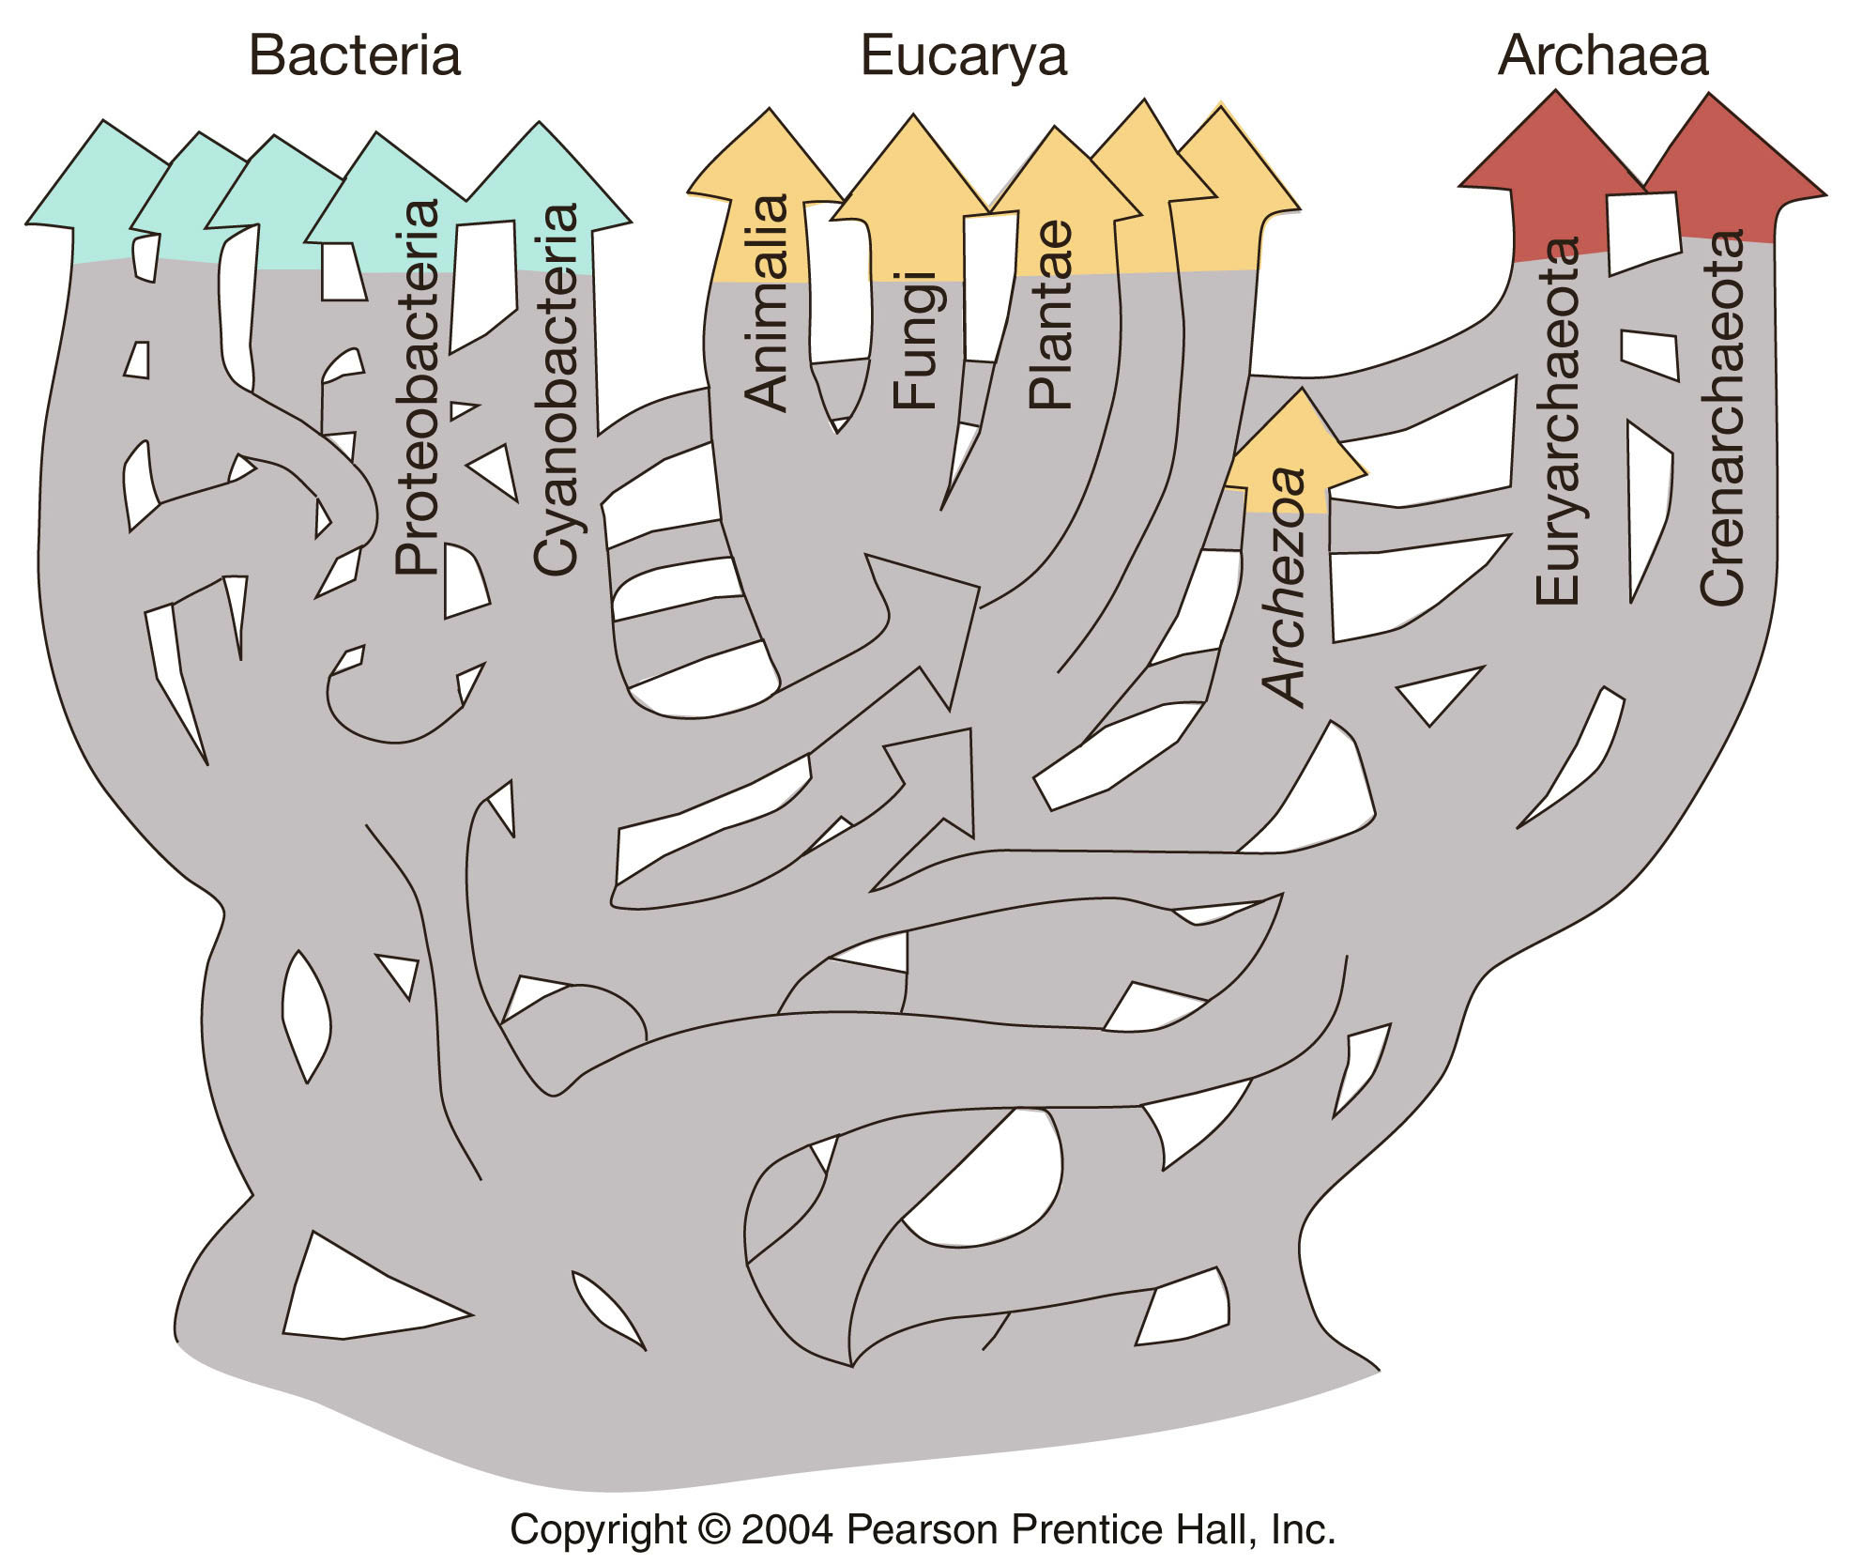
Horizontal gene transfer rampant in early life…
common ancestor not a single species, but community of species swapping genes
“TREE OF LIFE” concept is overly simplistic
“WEB OF LIFE” more appropriate?
From Freeman & Herron, Evolutionary Analysis

